Slide 1
FAST DC OFF-BOARD CHARGER FOR EV
Supervised by Prof. Dr. Ragi Hamdi and Prof. Dr. Ayman Samy

Slide 2


01
Overview

Slide 3
Overview
Off-board chargers are rapidly gaining popularity in the electric vehicle industry due to their lack of space constraints and fast charging capabilities. They offer a wide range of power control and can be used in Vehicle-to-Grid (V2G) applications. One of the main challenges with electric vehicles is the slow charging time; onboard chargers can take up to seven hours to fully charge a battery, whereas off-board chargers can recharge the battery in as little as 30 minutes.
OVERVIEW

Slide 4
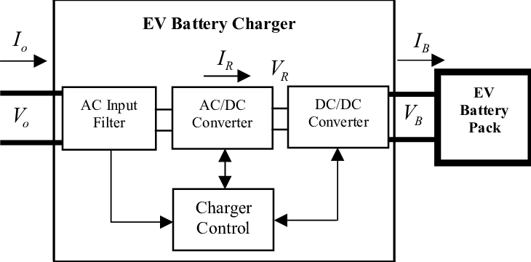
Overview
Project Implementation
Project Implementation

Slide 5
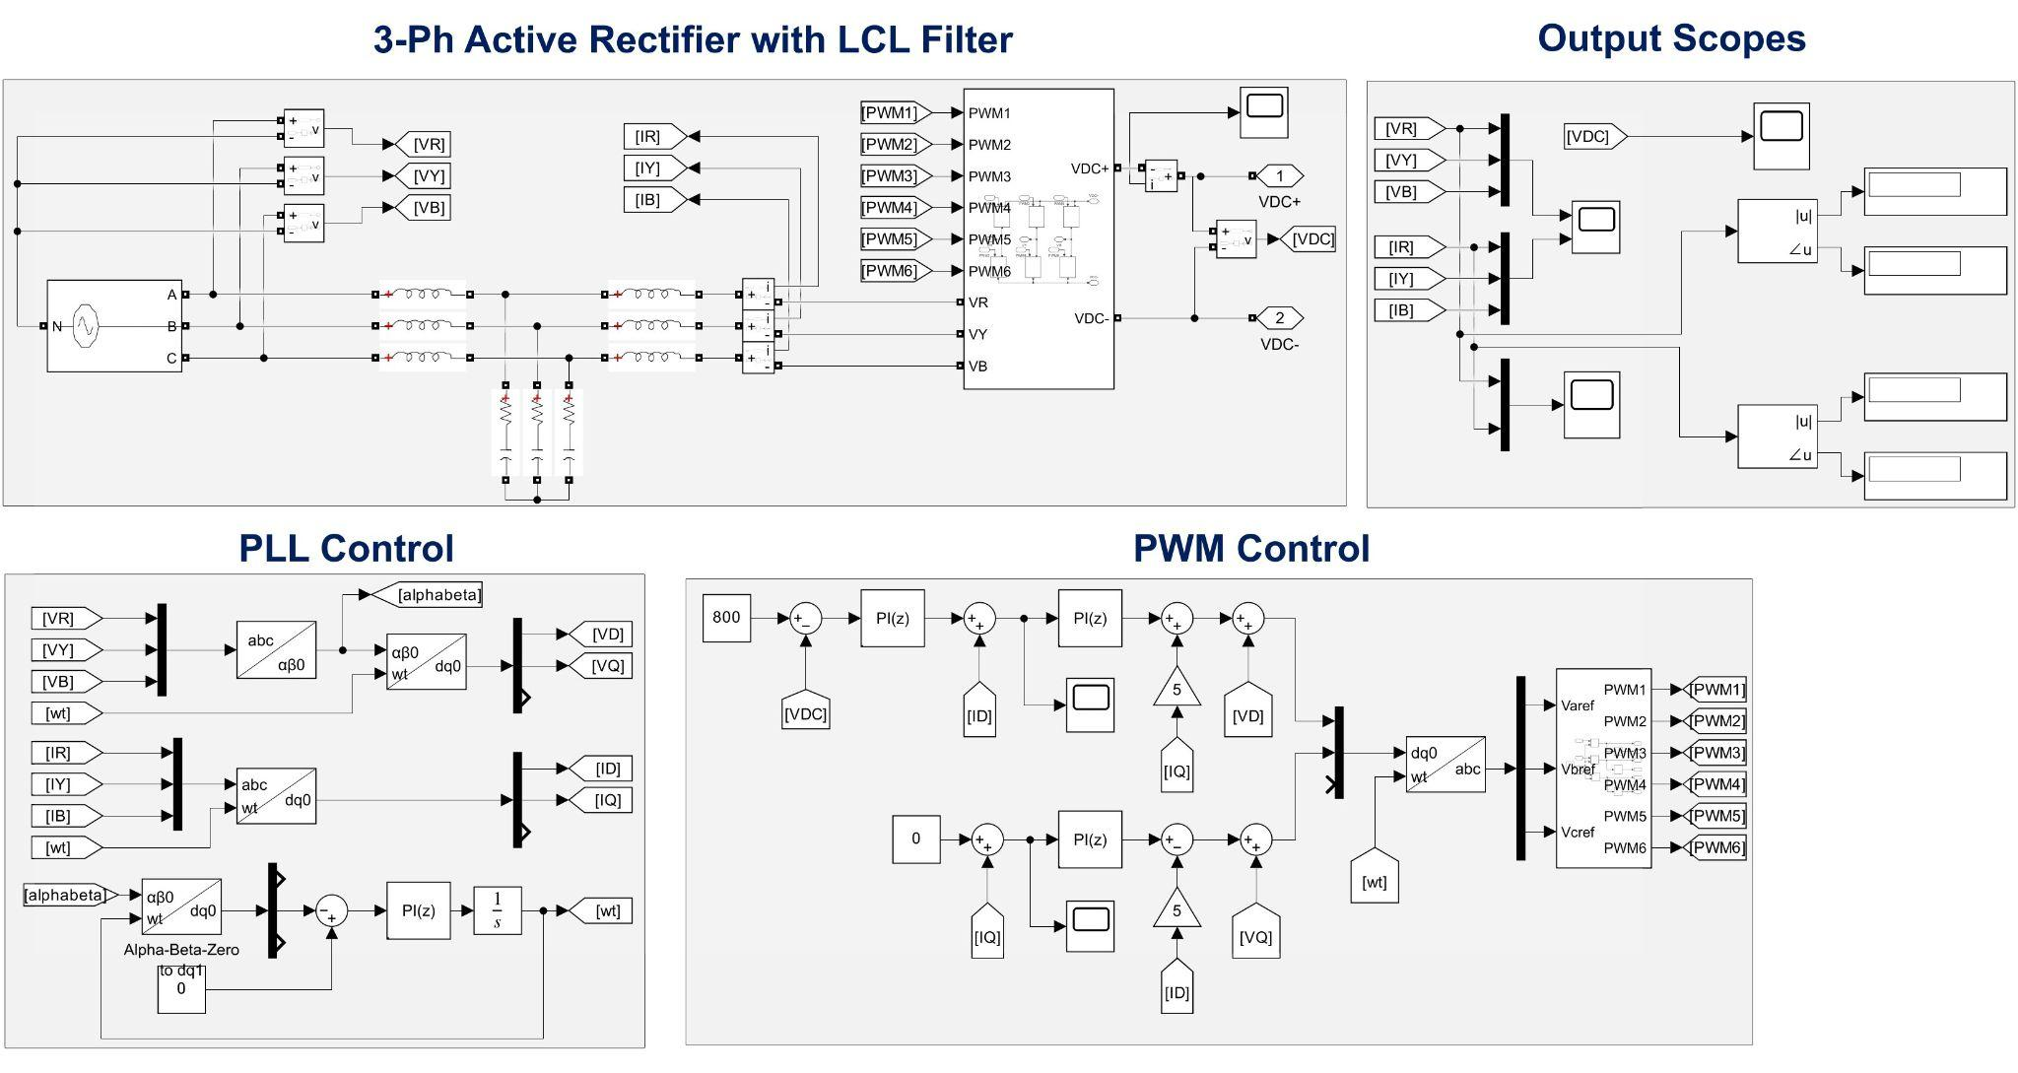
Overview
Active-Front-End (AFE) Rectifier
Active-Front-End (AFE) Rectifier

Slide 6
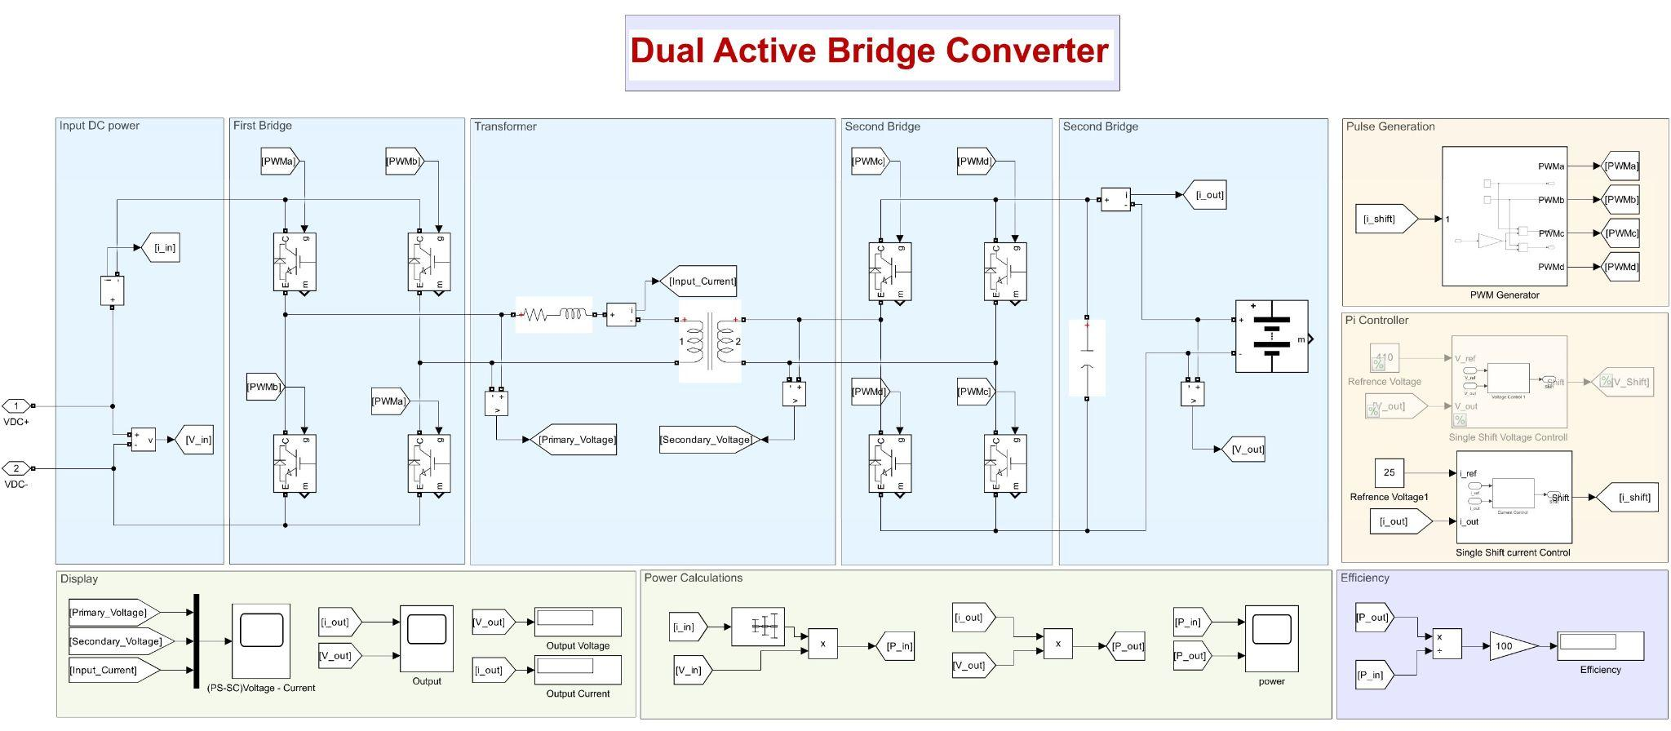
Overview
Dual-Active-Bridge DC/DC Converter
Dual-Active-Bridge DC/DC Converter

Slide 7
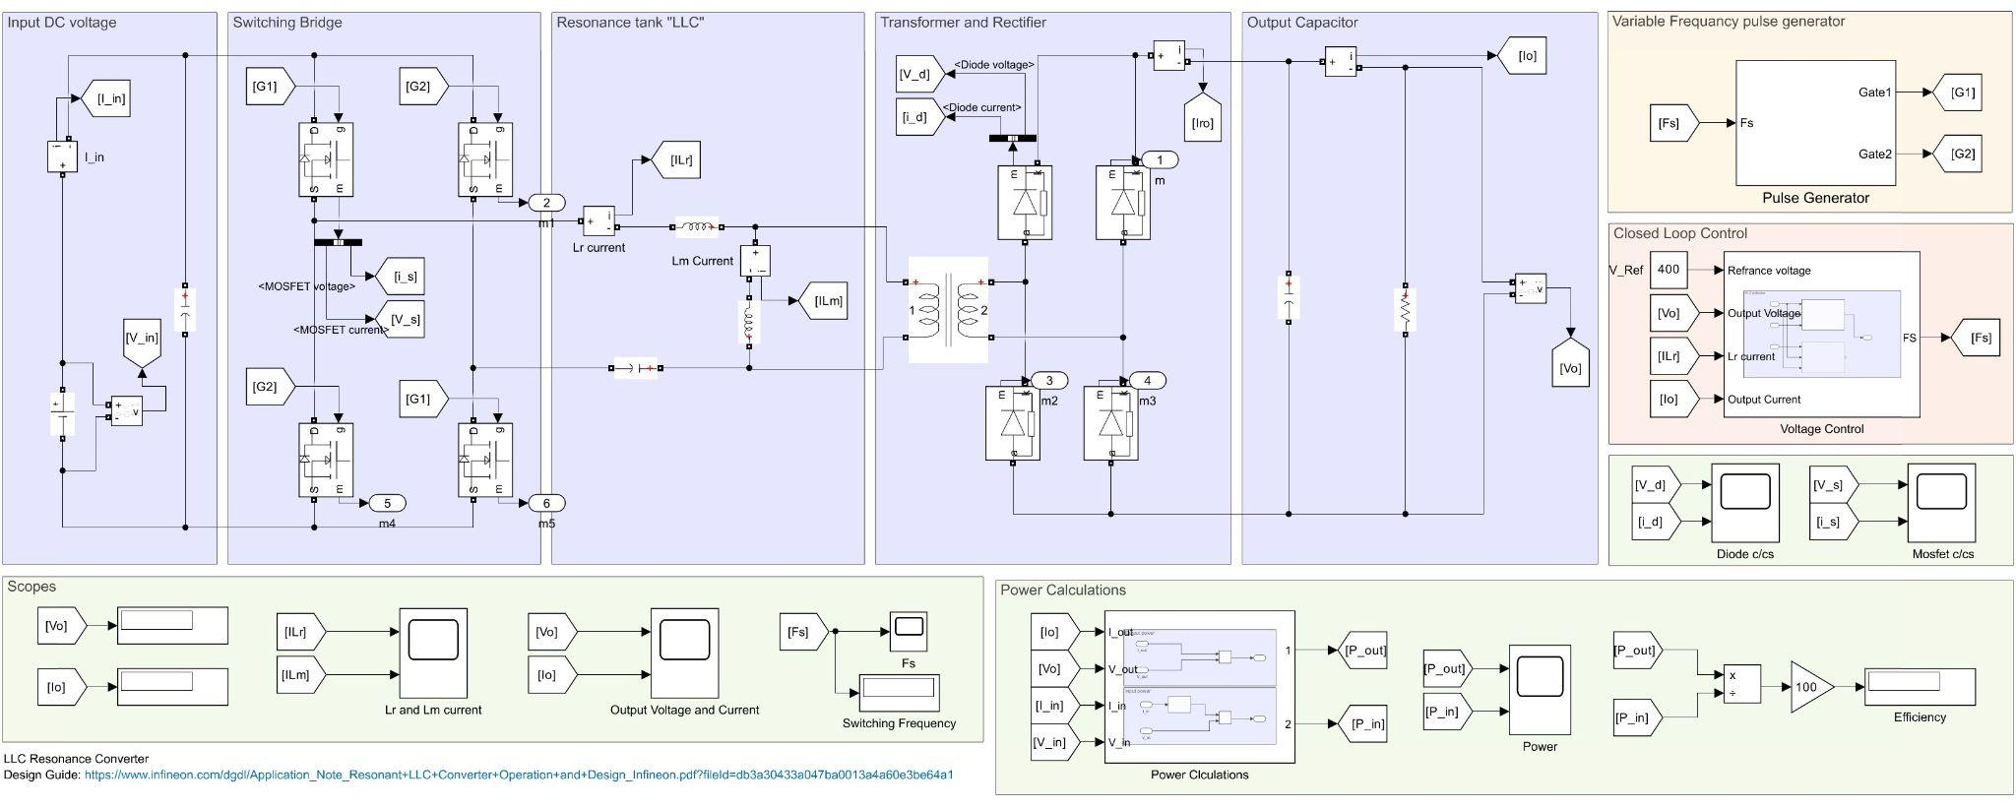
Overview
LLC DC/DC Converter
LLC DC/DC Converter

Slide 8
02
Filters for Grid-Connected Converters
Ensuring Power Quality and Grid Compliance

Slide 9
Grid-Connected Converters
Grid-connected converters play a crucial role in modern electrical power systems such as:
Integration with Renewable Energy systems.
Electric Vehicle Charging Stations.
Vehicle-to-Grid (V2G) systems.

Slide 10
Main Points
● Why Filters are needed In grid-Connected Converters.
● Types of Filters used in grid-connected converters.
● The Criteria to choose between the different types of Filters.
● Design Considerations that should be taken.

Slide 11
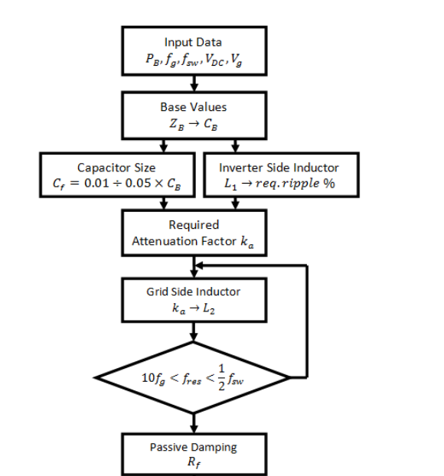
Design Algorithm

Slide 12


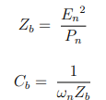
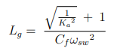
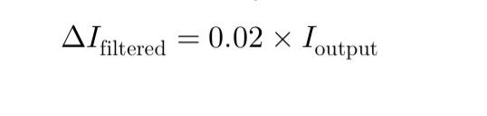
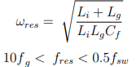
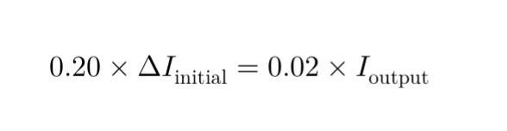
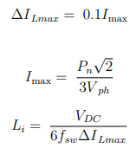
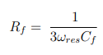
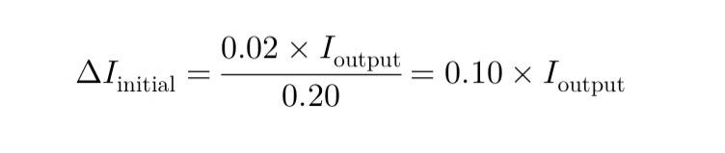
Calculations

Slide 13

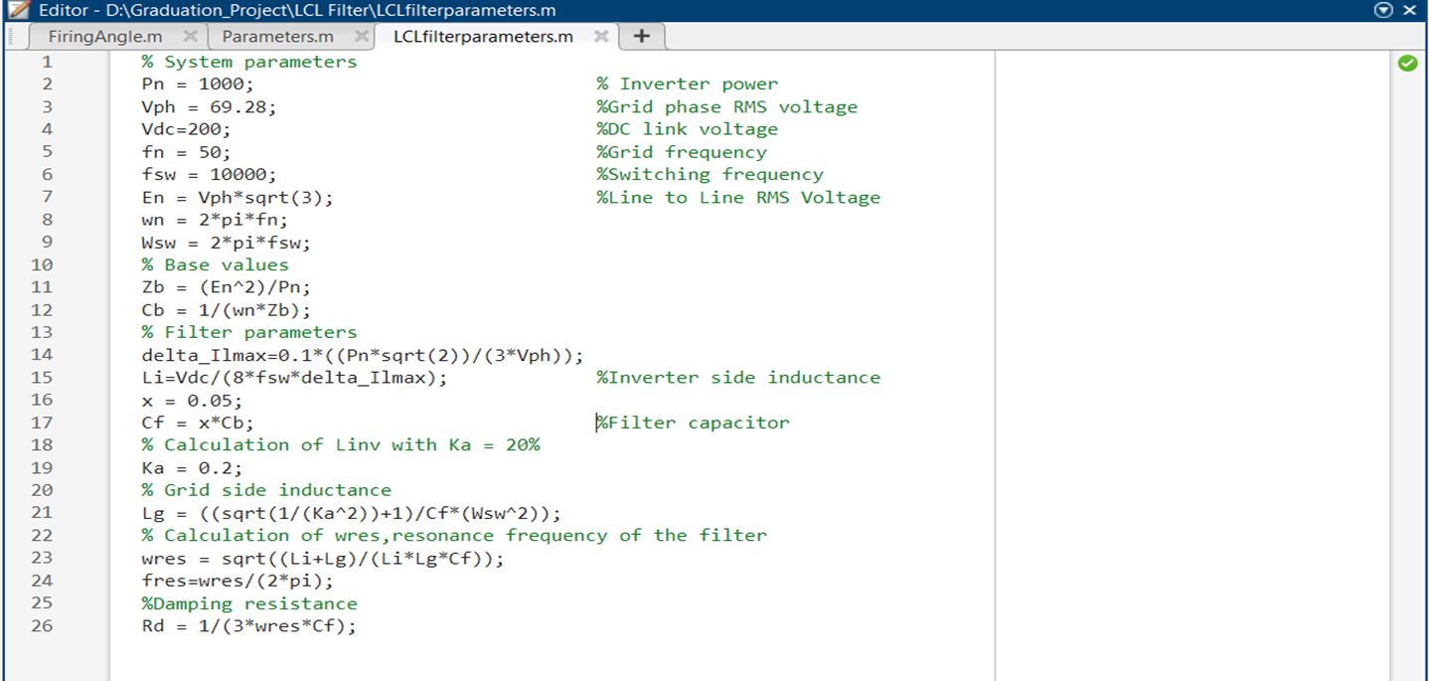
MATLAB Code

Slide 14
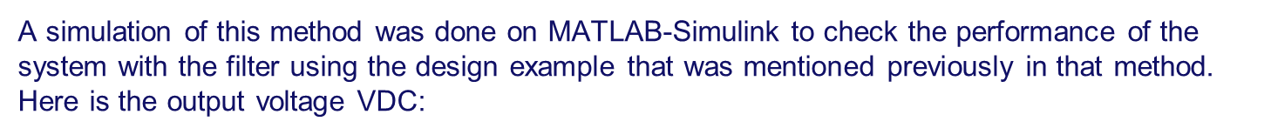
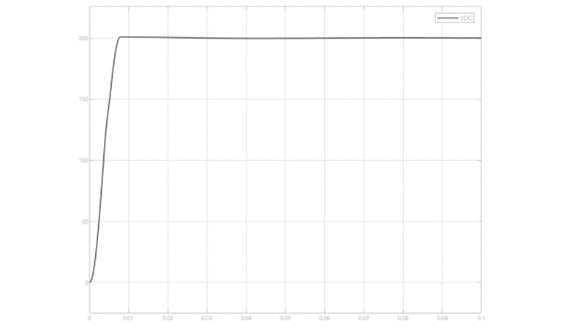
Results and Simulation

Slide 15
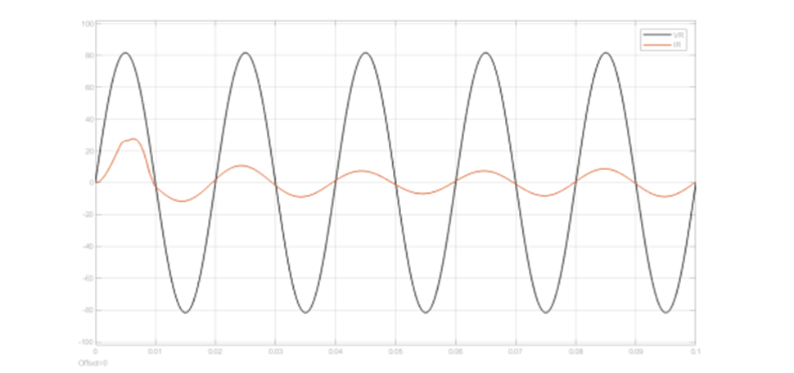

Slide 16
DC-Link Capacitor Calculations
Smoothing DC voltage: Acts as a reservoir to smooth out pulsations.
Energy storage: Provides or absorbs energy during transient conditions to maintain the desired DC Voltage.
Filtering harmonics: Filters harmonic currents generated by the Inverter’s switching operations.

Slide 17
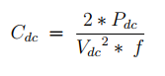
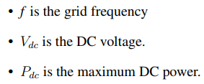
Calculations

Slide 18
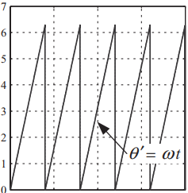
03
Phase Locked Loop
For Grid Synchronization and ensuring unity power factor

Slide 19
Phase Locked Loop
The PLL acts like a bridge between the AC grid and the DC output of the AFE rectifier.
The basic idea of the PLL system is a feedback system with a PI-regulator tracking the phase angle.
Input is the three phases of the grid voltage and output from the PLL is the phase angle of one of the three phases.

Slide 20
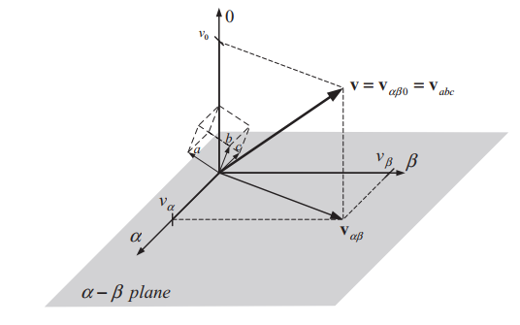
Stationary reference frame
To track the phase angle the three phase voltage signals Va, Vb and Vc are transferred from three phases to a stationary system of two phases Vα and Vβ.

Slide 21
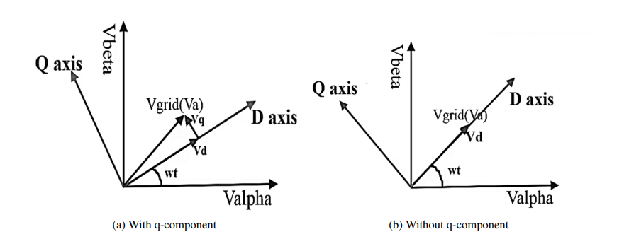
Synchronous rotating reference frame
The phase angle is tracked by synchronizing the voltage space vector along q or d axis in the SRF.

Slide 22
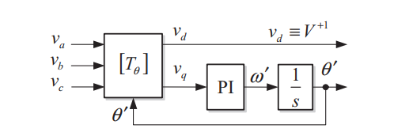
PLL block diagram

Slide 23
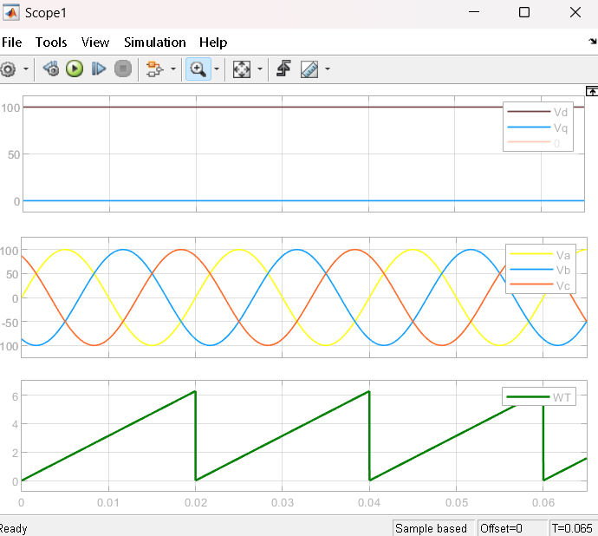
Simulation Results

Slide 24
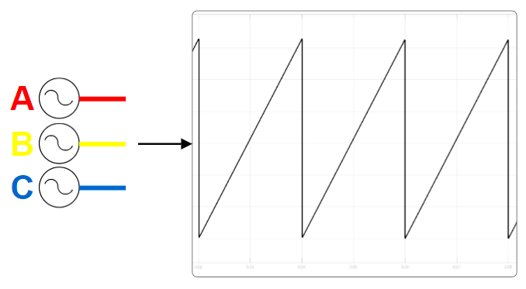
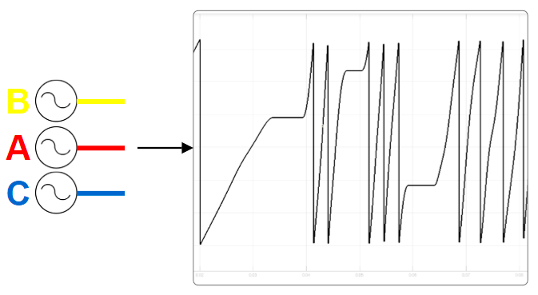
PLL Testing
This test is to ensure proper grid synchronization. By measuring phase voltages and utilizing the Three-Phase PLL Block in our Simulink model, we ensured accurate phase angle calculation before integrating the system with the grid.
Correct Phases-Sequence
(b) Incorrect Phases-Sequence

Slide 25
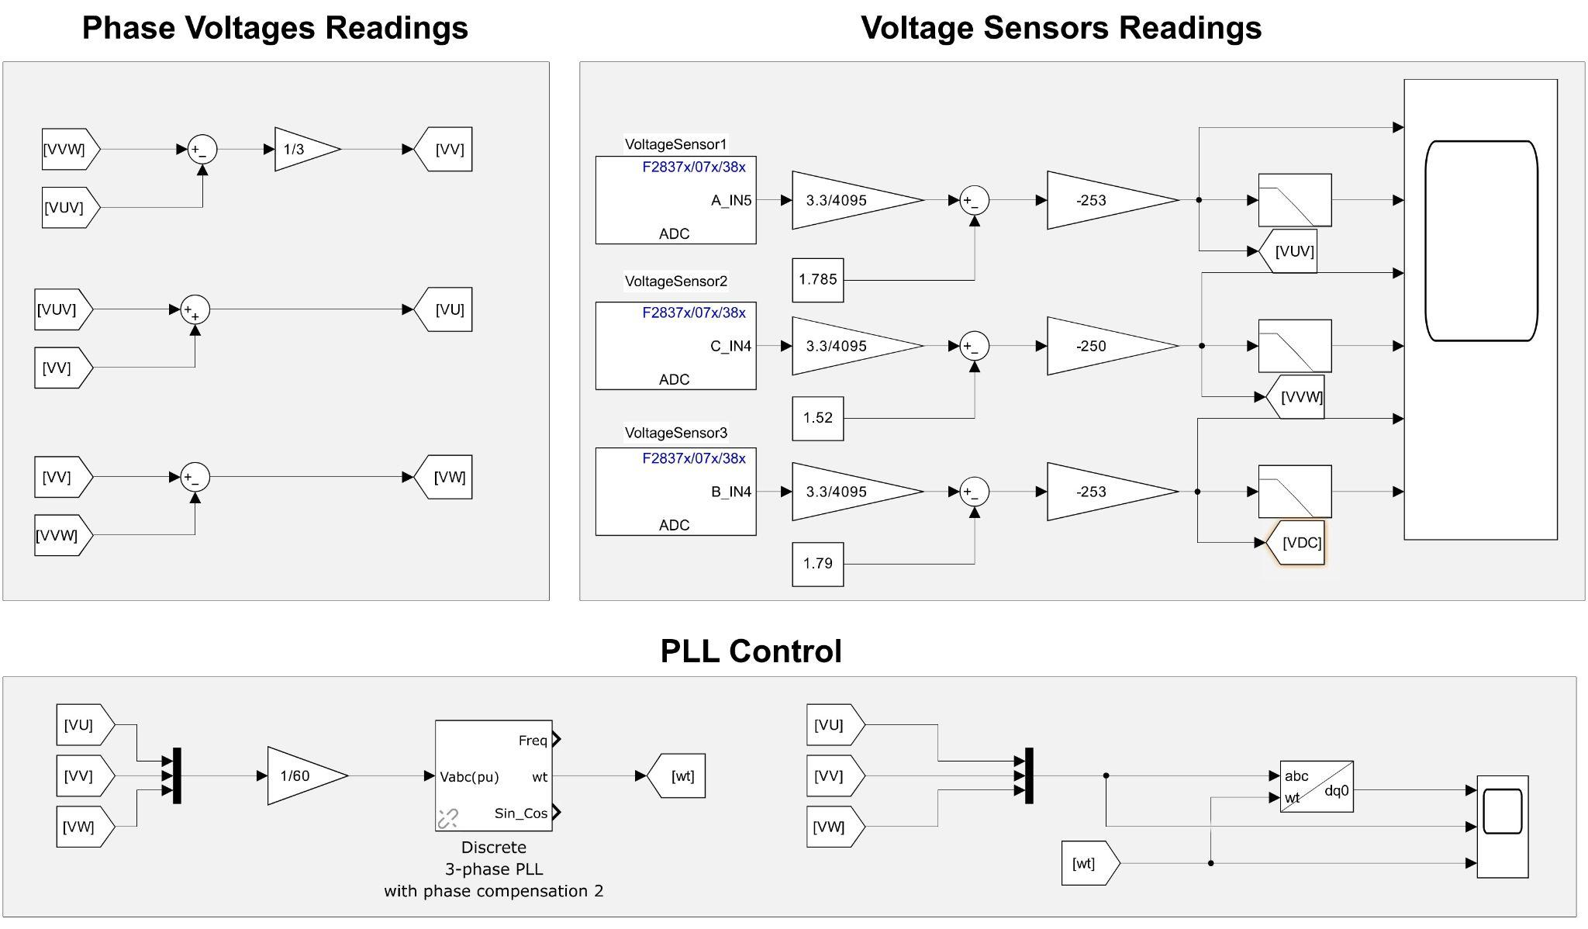
Practical Work
Phase-Locked Loop (PLL) Test
Simulink MATLAB Model

Slide 26
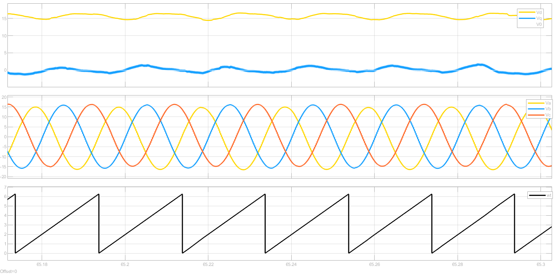
Practical Results

Slide 27
04
Control
System

Slide 28
control system construction mainly consists of 3 parts
Wt Vref
Wt Vref
System construction
PLL
Pi Controller
PWM generation

Slide 29
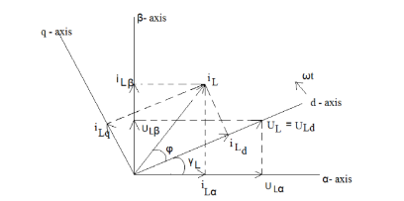
Objective :
Vdc control
Unity p.f
To obtain :
1- unity p.f
Pi controller

Slide 30
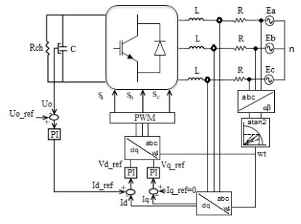
2-Vdc control :

Slide 31
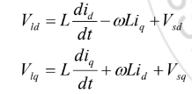
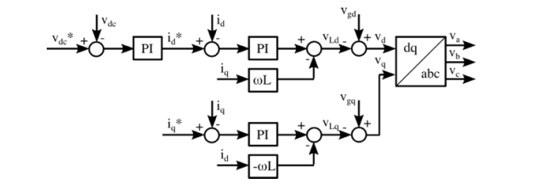
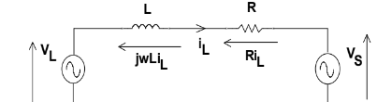
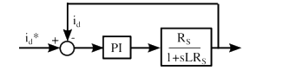
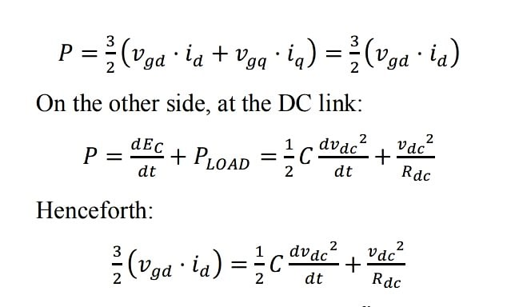
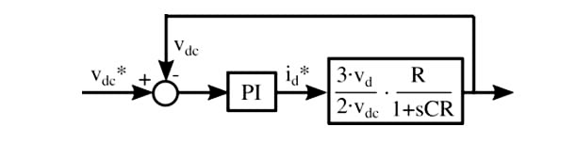
System implementation
Current loop (inner):
voltage loop (outer)

Slide 32
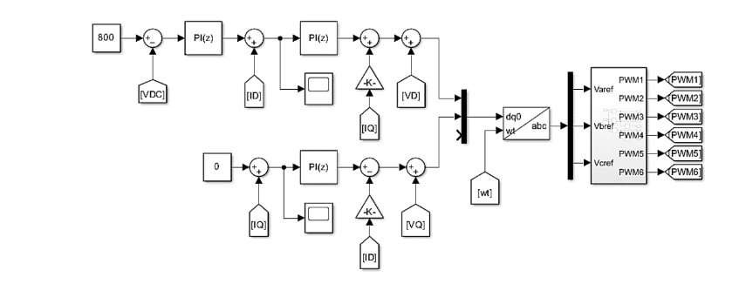
Simulation model

Slide 33
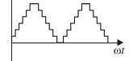
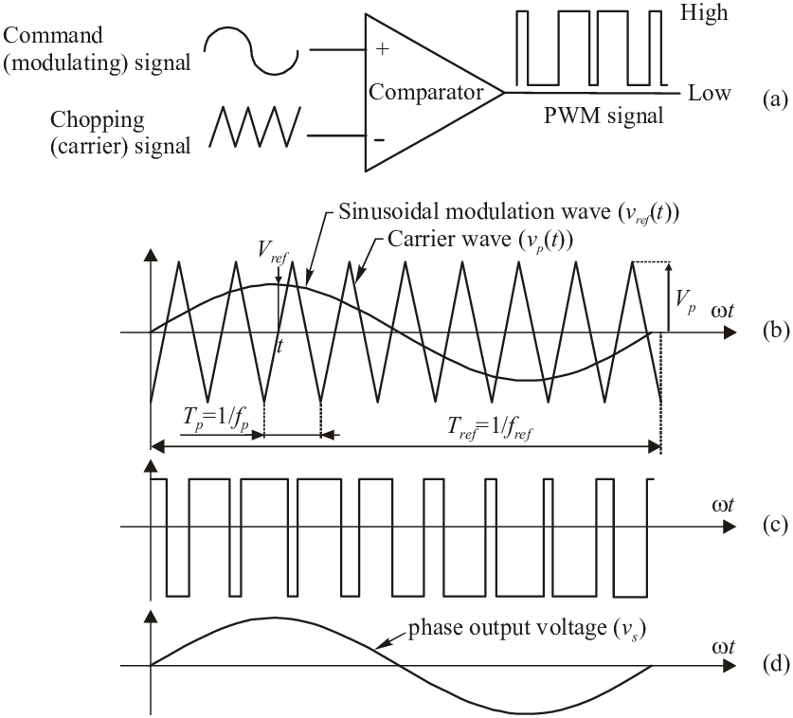
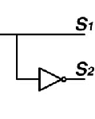
Pwm generation
V ref : output of the controller
Carrier:
1- counter mode
2- clock frequency
3-timer period
t= tc*n
n(top)=Fclck/2Fsw
Out : spwm

Slide 34
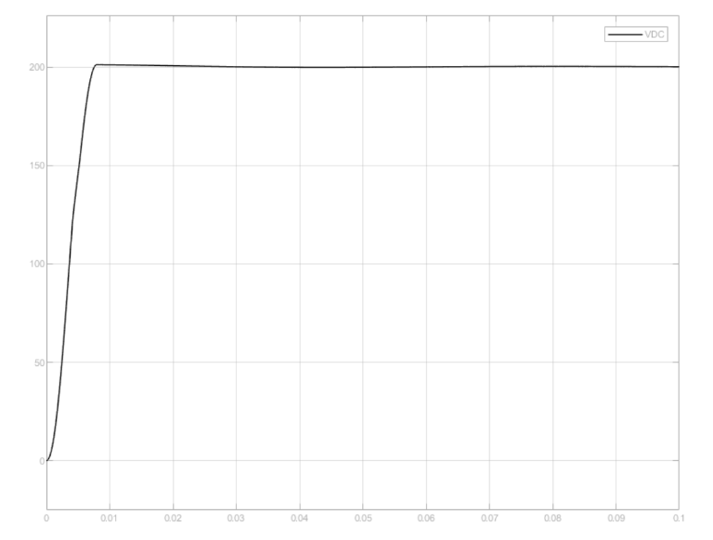
Results

Slide 35
05
Hardware
Design

Slide 36
Hardware Design
Voltage Sensor
Rectifier Board
3ph Grid
Controller
PWM
Current Sensor
DC Link

Slide 37
Hardware Design
Main Board

Slide 38
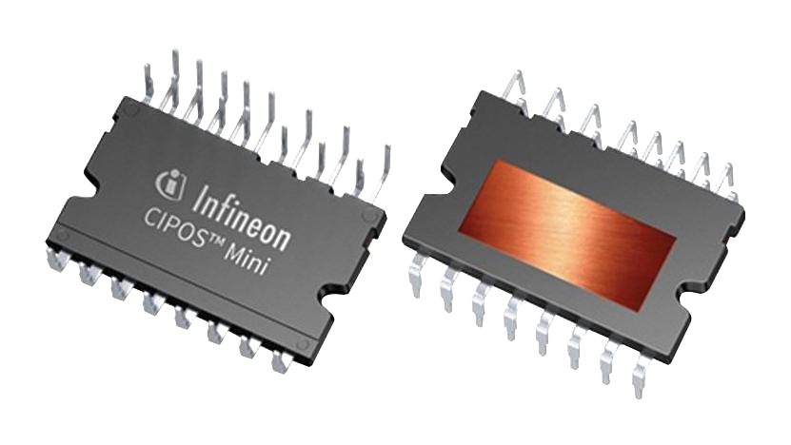
Hardware Design
Main Board
3Φ -bridge 600V / 30A
IKCM30F60GD
Notes:
Integrated bootstrap circuit
400V DC Maximum 6 IGPT

Slide 39
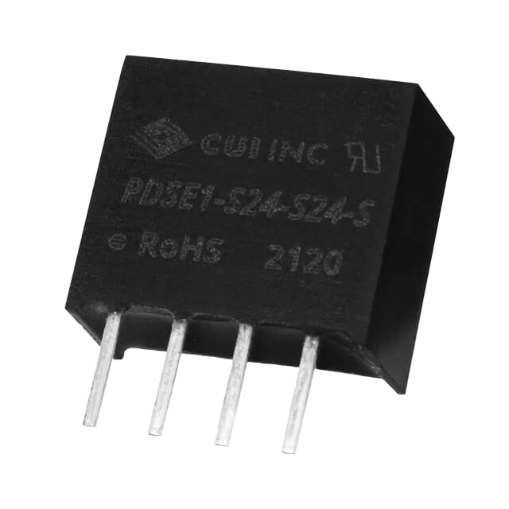
Hardware Design
Main Board
Isolated DC-DC Transformer
PDSE1-S15-S15-S
Notes:
Flyback converter

Slide 40
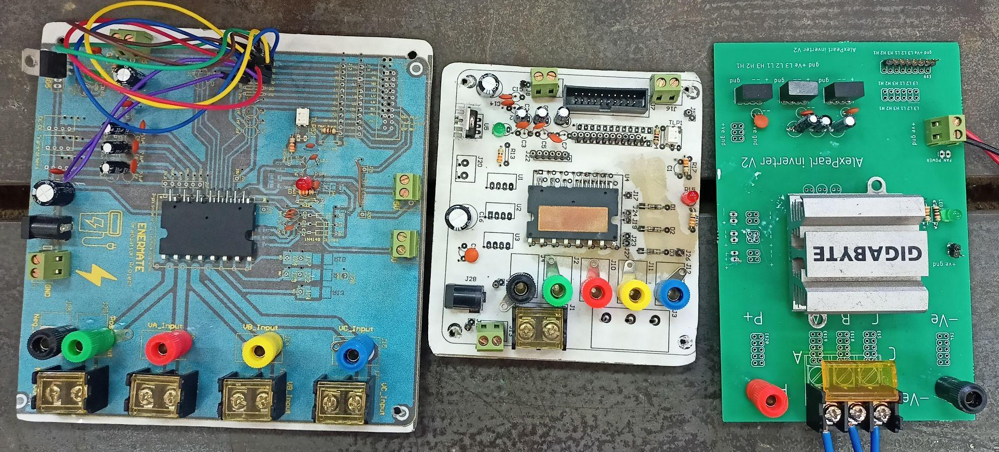
Hardware Design
Main Board
Versions of the Main Board
AC/DC Converter Board
Notes:
RC Circiut Same power of signal and ic

Slide 41
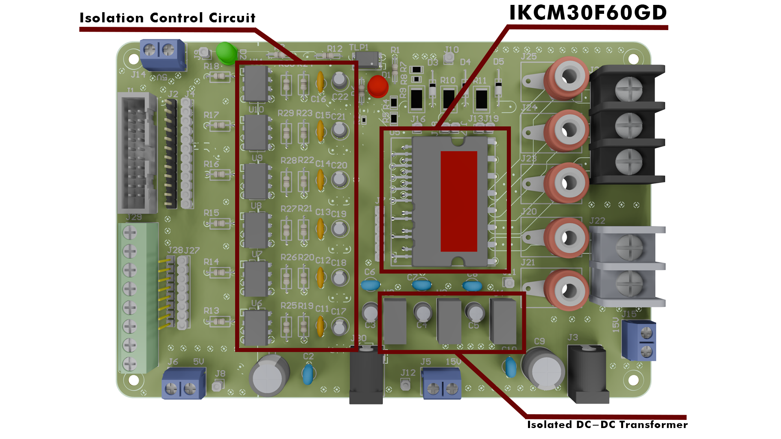
Hardware Design
Main Board
Last Version of the Main Board

Slide 42
Hardware Design
Interfacing Board

Slide 43
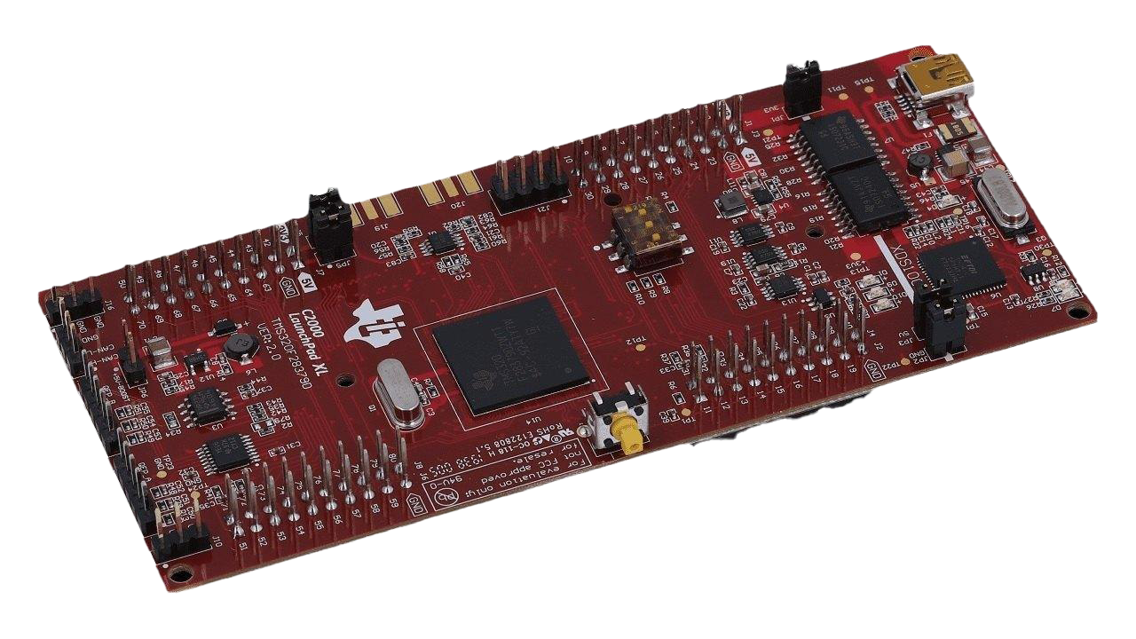
Hardware Design
Interfacing Board
Microcontroller
Launchpad F28379D

Slide 44
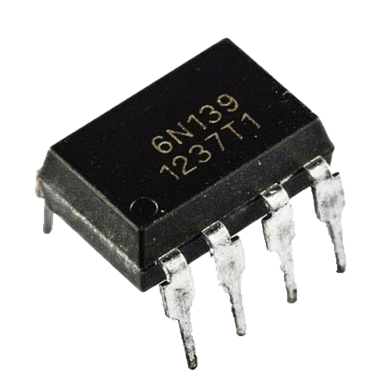
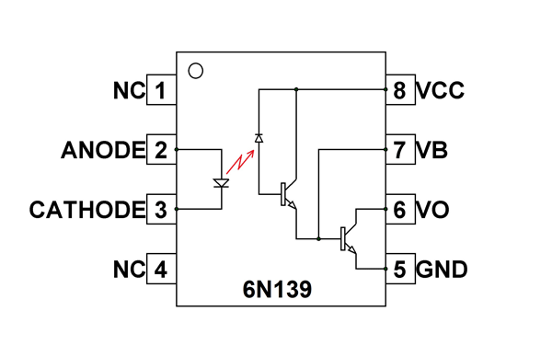
Hardware Design
Interfacing Board
Optocoupler
6n139

Slide 45
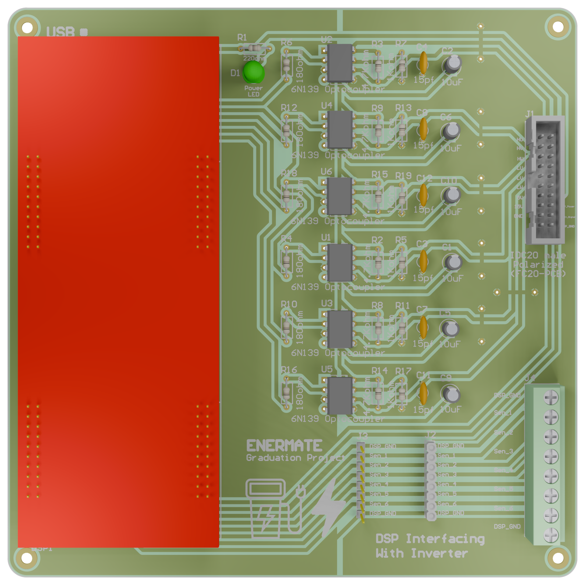
Hardware Design
Interfacing Board
DSP Interfacing
Board

Slide 46
Hardware Design
Voltage Sensor
Board

Slide 47
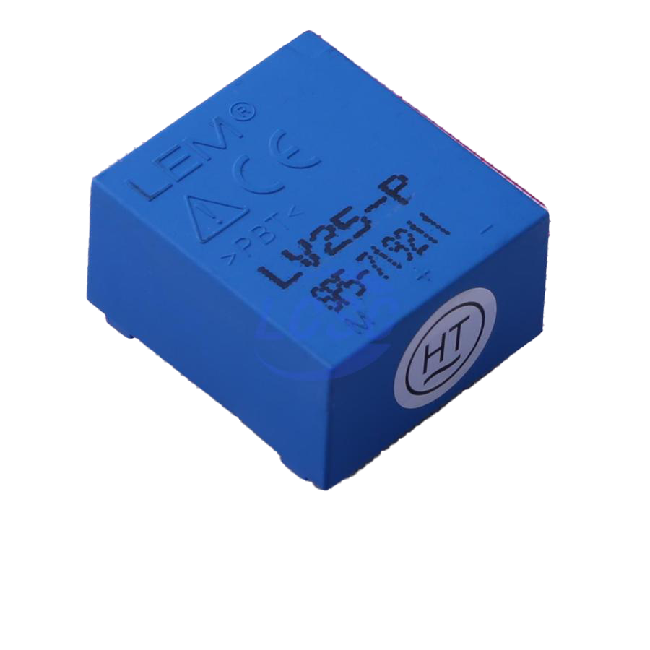

Hardware Design
Voltage Sensors Board
Voltage Sensors
LV 25-P

Slide 48



Hardware Design
Voltage Sensors Board
Voltage Sensors Needs

Slide 49

Hardware Design
Voltage Sensors Board
Voltage
Sensors
Board

Slide 50
Hardware Design
Current Sensor
Board

Slide 51



Hardware Design
Current Sensors Board
Current Sensors
LV 25-P
ACS712
LA 55-P

Slide 52

Hardware Design
Current Sensors Board
Current
Sensors
Board

Slide 53
Hardware Design
Hardware System

Slide 54

Hardware System

Slide 55

Hardware System

Slide 56

Hardware System

Slide 57

06
Practical Work

Slide 58
Practical Work
Overview
The two main categories of AC/DC conversion tests: Pre-Operational and System-Level. The pre-operational tests support the system-level tests and ensure overall system health, while the system-level tests directly assess the core functionalities of the charger.
Pre-Operational Tests
System-Level Tests
Sensors Testing
Phase-Locked Loop (PLL) Test
Inverter Open-Loop Functionality Test
Current-Controlled Inverter Test

Slide 59
Practical Work
Sensors Testing

Slide 60


Practical Work
Sensors Testing
Objective
We evaluated both the voltage sensor (LV 25-P) and the current sensor (LTS 25-P). The voltage sensor was tested for accurate output and proper biasing, while the current sensor was tested for accurate AC/DC current measurement and response.
Voltage Sensor Diagram
(b) Current Sensor Diagram

Slide 61

Practical Work
Sensors Testing
Simulink MATLAB Model

Slide 62

Practical Work
Sensors Testing
Results

Slide 63
Practical Work
Inverter Open-Loop Functionality Test

Slide 64

Practical Work
Inverter Open-Loop Functionality Test
Objective
The open loop test was performed to gradually progress toward closed-loop voltage control, which is essential for the final implementation. This test involved a three-phase motor, where we generated a six-step phase voltage as the output of the inverter module.

Slide 65

Practical Work
Inverter Open-Loop Functionality Test
Simulink MATLAB Model

Slide 66

Practical Work
Inverter Open-Loop Functionality Test
Results

Slide 67
Practical Work
Current-Controlled Inverter Test

Slide 68

Practical Work
Current-Controlled Inverter Test
Objective
This test was conducted in two parts: first, connecting to a star-connected inductive load, and second, connecting to the grid. We controlled the output current and monitored the system's response to different reference current settings, verifying its stability and accuracy. Note that this test require all the pre-operational tests to be done at first.

Slide 69

Practical Work
Current-Controlled Inverter Test
Simulink MATLAB Model

Slide 70

Practical Work
Current-Controlled Inverter Test
Results

Slide 71
07
DC-DC Part

Slide 72


Why DC-DC Converter :

Slide 73

Dual Active Bridge :

Slide 74



Control Technique:
· Single-Phase Shift (SPS) Control.
Power Transfer :

Slide 75

Simulation Model :

Slide 76

Shifted PWM Signal Between First and Second Bridge

Slide 77

Results :
Output Current and Voltage Using CC for DAB

Slide 78

Output Current and Voltage Using CV for DAB

Slide 79
08
Practical Work

Slide 80


Slide 81


Slide 82


Slide 83

Output voltage from bridge

Slide 84


Slide 85


Slide 86


Slide 87


Slide 88


Slide 89
09
LLC
Converter

Slide 90

Circuit schematic

Slide 91

Resonant tank gain

Slide 92

Resonant tank gain

Slide 93
Advantages and disadvantages
Reduces switching losses with ZVS & ZCS
High power density
Lower electromagnetic interference (EMI)
Wide input voltage range
Complex design
Control challenges
Design and development cost

Slide 94

Modes of operation

Slide 95

Modes of operations

Slide 96

Modes of operations

Slide 97

Modes of operations

Slide 98
How to Design LLC Resonant Converter?

Slide 99
Design LLC Resonant Converter

Slide 100
Design LLC Resonant Converter
MATLAB Script File
%-------------- Transformer and Load -----------------
a_sp = (Vo_max+Vo_min)/(2*Vin_rated); % Ns/Np ratio
a_sp2 = a_sp*a_sp;
% rated load resistance
Ro_rated = Vo_rated*Vo_rated/Po_rated;
% Ro_rated referred to the primary side
Ro_rated_pri = Ro_rated/a_sp2;
% load resistance at the operating conditions
Ro = Ro_rated/K_load;
%-------------- Resonant Circuit -----------------
% Minimum gain and maximum gain required
G_dc_min = Vo_min/(a_sp*Vin_max); % minimum gain
G_dc_max = Vo_max/(a_sp*Vin_min); % maximum gain
% resonant inductance
Ls = (Q_rated*Ro_rated_pri)/(2*pi*f_res);
% resonant capacitance
Cs = 1/(2*pi*f_res*Q_rated*Ro_rated_pri);
% transformer magnetizing inductance
Lm = K_ind*Ls;
% Q value at the operating conditions
%Q = Zo / R; Zo = sqrt(Ls/Cs);
Q = sqrt(Ls/Cs)/(Ro/a_sp2);
%-------------- DC Input -----------------
Vin = 700; % operating input voltage
Vin_rated = 700; % rated input voltage
Vin_min = 650; % minimum input voltage
Vin_max = 800; % maximum input voltage
%-------------- Output Load -----------------
Vo = 450; % operating output voltage
Vo_rated = 450; % rated output voltage
Vo_min = 400; % minimum output voltage
Vo_max = 600; % maximum output voltage
Po_rated = 7000; % rated output power
% load percentage with respect to the rated load
K_load = 1;
Q_rated = 0.3; % Q factor at the rated condition
%-------------- Operating Conditions -----------------
f_res = 70000; % resonant frequency
K_ind = 6; % parallel-to-series inductance ratio
% relative frequency factor for open-loop operation
K_rel_freq = 0.75;
fsw = f_res*K_rel_freq; % switching frequency fsw

Slide 101
LLC Resonant Converter Output Voltage Control

Slide 102

Voltage Control: Cascaded Control Loop
Controlling Output Voltage and Output Current

Slide 103
LLC Resonant Converter Simulation

Slide 104
Simulation Model Ratings and Parameters:
Input voltage: 650 - 800 volt rated 700 Volt.
Output voltage: 350 - 500 volt rated 400 Volt.
Transformer turns ratio Np/Ns = 700/400.
Frequency 70K Hz.
Rated power: 7000 watt.
Lr: 3.8e-05 H.
Lm: 2.32e-04 H.
Cr: 1.3e-07 F.

Slide 105

In Case of Reference = 400V

Slide 106
In Case of Reference = 400V

Slide 107

In Case of Reference = 350V
Buck converter

Slide 108
In Case of Reference = 350V
Buck converter

Slide 109

In Case of Reference = 500V
Boost converter

Slide 110
In Case of Reference = 500V
Boost converter

Slide 111

10
High Frequency Transformer

Slide 112
High Frequency Transformer
Why HF Transformer?

Slide 113

High Frequency Transformer
Why HF Transformer?
W
Electrical Isolation.
Step up/step down for input voltage.
Size and Weight Reduction.
Improved Efficiency.
High Power Density.
Notes:
Integrated bootstrap circuit
400V DC Maximum 6 IGPT

Slide 114


High Frequency Transformer

Slide 115
High Frequency Transformer
HF Transformer Design

Slide 116
High Frequency Transformer
HF Transformer Design
Design Procedures
Core material Choice
Number of Turns
Step 2
Step 4
Step 1
Step 3
System Requirements
Testing Power
Notes:
Flyback converter

Slide 117
High Frequency Transformer
HF Transformer Design
Design Procedures
Number of Layers
Some Checks
Step 6
Step 8
Step 5
Step 7
Diameter of Wire
Length of Wire
Notes:
Flyback converter

Slide 118
High Frequency Transformer
HF Transformer Design
Design Procedures
System Requirements
Switching Frequency in KHz.
Output Power in Watt.
Input Voltage in V.
Output Voltage in V.
Notes:
RC Circiut Same power of signal and ic

Slide 119

High Frequency Transformer
HF Transformer Design
Design Procedures
Core Material Choice
Notes:
RC Circiut Same power of signal and ic

Slide 120


High Frequency Transformer
HF Transformer Design
Design Procedures
Core Material Choice
Notes:
RC Circiut Same power of signal and ic

Slide 121


High Frequency Transformer
HF Transformer Design
Design Procedures
Power Check
Notes:
RC Circiut Same power of signal and ic

Slide 122




High Frequency Transformer
HF Transformer Design
Design Procedures
Number of Turns
Notes:
RC Circiut Same power of signal and ic

Slide 123



High Frequency Transformer
HF Transformer Design
Design Procedures
Diameter of Wire
Notes:
RC Circiut Same power of signal and ic

Slide 124


High Frequency Transformer
HF Transformer Design
Design Procedures
Number of Layers
Notes:
RC Circiut Same power of signal and ic

Slide 125
High Frequency Transformer
HF Transformer Design
Design Procedures
Length of Wire
Length of Wire = Number of Turns * Length of Complete Turn
+ Additional 10 or 20 cm (according to design) for the terminals = Number of turns * (2 * c + 2 * F) + 10 * 10
Checking the Voltage Drop is done by:
(Value from Table) --------→1000 m
? --------→ Length of Wire
Notes:
RC Circiut Same power of signal and ic

Slide 126

High Frequency Transformer
HF Transformer Design
Design Procedures
Length of Wire
Notes:
RC Circiut Same power of signal and ic

Slide 127

High Frequency Transformer
HF Transformer Design
Design Procedures
Some Notes and Differences For Secondary Side
Notes:
RC Circiut Same power of signal and ic

Slide 128
High Frequency Transformer
HF Transformer Design
Design Procedures
Results of Both High and Low Rating
 | Low Rating | High Rating
Core Type and Material | EI Ferrite (P-Material) 46022 EE or 46022 EC | EI Ferrite (P-Material) 49928EE or 49928EC
Effective Area of Core | 402 mm squared | 738 mm squared
Core Dimension | 60/31/22 | 100/59/27
Number of turns | 16 turns | 26 turns
Diameter of Wire for both sides | 0.57404 mm | 0.40386 mm
Number of Parallel Wires in Primary Side | 8 Wires | 37 Wires
Number of Parallel wires in Secondary Side | 7 Wires | 34 Wires
Number of Layers in Primary Side | 4 Layers | 9 Layers
Number of Layers in Secondary Side | 4 Layers | 7 Layers
Length of Wire | 1.41296 m | 3.012 m
Notes:
RC Circiut Same power of signal and ic

Slide 129

High Frequency Transformer
HF Transformer Design
The Practical Design
 | Low Rating (Practical)
Core Type and Material | UU Ferrite Series/Type: B67345
Effective Area of Core | 840 mm squared
Core Dimension in mm | 93/152/30
Number of turns | 9 turns
Diameter of Wire for both sides | 0.91186 mm
Number of Parallel Wires in Primary Side | 6 Wires
Number of Parallel wires in Secondary Side | 6 Wires
Number of Layers in Primary Side | 2 Layers
Number of Layers in Secondary Side | 2 Layers
Length of Wire | 1.1638 m
Notes:
RC Circiut Same power of signal and ic

Slide 130


High Frequency Transformer
HF Transformer Design
The Practical Design
Notes:
RC Circiut Same power of signal and ic

Slide 131
11
Charger Integration

Slide 132

Charger Integration
AFE Rectifier and DAB Converter
Off-Board Charger Implementation Using AFE Rectifier and DAB Converter

Slide 133

Charger Integration
AFE Rectifier and DAB Converter
The Results:
Unity Power Factor

Slide 134

Charger Integration
AFE Rectifier and DAB Converter
The Results:
DC Output of Rectifier

Slide 135

Charger Integration
AFE Rectifier and DAB Converter
The Results:
DC Output of The DAB Converter

Slide 136

Charger Integration
AFE Rectifier and LLC Converter
Off-Board Charger Implementation Using AFE Rectifier and LLC Converter

Slide 137

Charger Integration
AFE Rectifier and LLC Converter
The Results:
Unity Power Factor

Slide 138

Charger Integration
AFE Rectifier and LLC Converter
The Results:
DC Output of Rectifier

Slide 139

Charger Integration
AFE Rectifier and LLC Converter
The Results:
DC Output of The LLC Converter

Slide 140
Thanks!

